Slide 1
APIs with Node.js and Express.js

Slide 2
Table of Contents
Introduction to backend
Basic overview of node, express and MongoDB with required packages
Explanation of flow of Web and API with its HTTP methods.
Building and testing REST API.
Engineering the code and folder structure.
A bigger picture of a project
Concepts ahead (middlewares, static files, authentication, etc.)
Notes:
Creating issue with post route

Slide 3
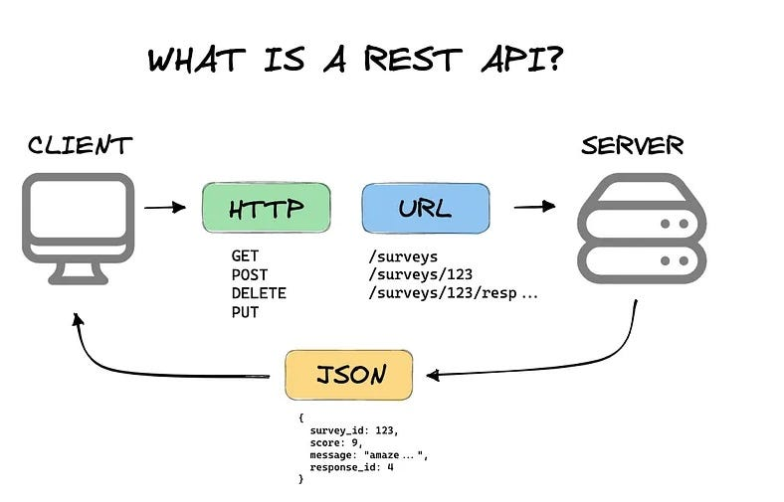
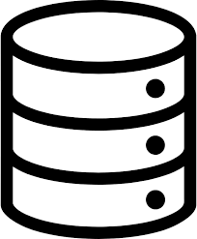
Database

Slide 4
Query:
http://localhost:5000/api/students?age=20&grade=A
Params:
http://localhost:5000/api/students/123
Body:
POST http://localhost:5000/api/students
Content-Type: application/json
{
"name": "John Doe",
"age": 20,
"grade": "A",
"email": "john.doe@example.com"
}

Slide 5
When to Use Each
Query Parameters:
Filtering: /students?age=20
Sorting: /students?sort=age
Pagination: /students?page=2&limit=10
Searching: /students?name=John
Route Parameters:
Resource Identification: /students/123
Sub-resources: /students/123/grades
Request Body:
Complex data:
POST: For creating a resource.
PUT/PATCH: For updating a resource.
Typically not used in GET or DELETE requests.

Slide 6
Node.js:
{
name: “Shayaan”,
age: 19
}
Mongo DB
{
name: “Shayaan”,
age: 19
}
ODM
ORM
SQL Table
Name | Age
Shayaan | 19

Slide 7
Resources
https://www.npmjs.com/package/express
https://www.npmjs.com/package/nodemon
https://www.npmjs.com/package/mongoose
Article about MVC:
https://medium.com/@gecno/node-js-express-mongodb-and-mongoose-understanding-the-mvc-model-678952631ea3

